Slide 1
Introduction to VHDL part 1
Fall 08

Slide 2
Preliminary
Class web page http://www.people.vcu.edu/~jhtucker/f08-egre365/index.html
Syllabus Grades:
  Quizzes (2) 40%
  Homework 10%
  Laboratory 10%
  Design Project 15%
  Final Exam 25%
Text book The Student’s Guide to VHDL.
  This will be used primarily as a reference.

Slide 3
What is VHDL?
We will use VHDL to model digital systems.
VHDL = VHSIC Hardware Description Language
  VHSIC = Very High Speed Integrated Circuit
Developed in 1980’s by DOD.
Veralog is an older hardware description language.
  Some (for example ASIC designers) prefer Veralog.
ANSI/IEEE Std 1076-2002 is the version we will use.
  ANSI/IEEE Std 1076-2008 is the newest version.
VHDL is a very complex language.
A system can be described and simulated using VHDL.
VHDL descriptions can be synthesized and implemented in programmable logic.
  Synthesis tools can accept a only subset of VHDL.

Slide 4
VHDL
Primarily for modeling digital systems.
  Lesser extent analog
  We will consider only digital systems
Reasons for modeling
  Specify requirements
  Simulation, testing, verification
  Synthesis
Advantage
  Increase reliability
  Minimize cost and design time
  Increase flexibility and ease with which a system can be modified.
  Avoid design errors through use of simulation.
Problem
  We model our conception of the system.
  May not accurately reflect reality.

Slide 5
A VHDL program
library IEEE;
use IEEE.STD_LOGIC_1164.ALL;
use IEEE.STD_LOGIC_ARITH.ALL;
use IEEE.STD_LOGIC_UNSIGNED.ALL;
entity ABorC is
port (A : in std_logic;
B : in std_logic;
C : in std_logic;
F : out std_logic);
end ABorC;
architecture arch of ABorC is
signal X : std_logic;
begin
X <= A and B after 1 ns;
F <= X or C after 1 ns;
end;

Slide 6
Types chapter 2
The concept of type is important and fundamental when describing data in VHDL.
The type of a data object defines the set of values that an object can assume, as well as the set of operations that can be performed on those values.
  For example data object of type bit can assume a value of either ‘0’ or ‘1’, and can support operators such as “and”, “or”, “xor”, “nand”, etc.
Each object in VHDL has to be of some type.
VHDL is a strongly typed language.
Scalar data types consists of single, indivisible values.
Besides the usual types such as integer and real, VHDL also provides other types such as time and bit.
User defined types are frequently employed.
We will make extensive use of standard libraries that define special types such as stdlogic.
  We will use stdlogic in place of bit. Stdlogic can assume more values that 0 and 1. For example high impedance and don’t care values.

Slide 7
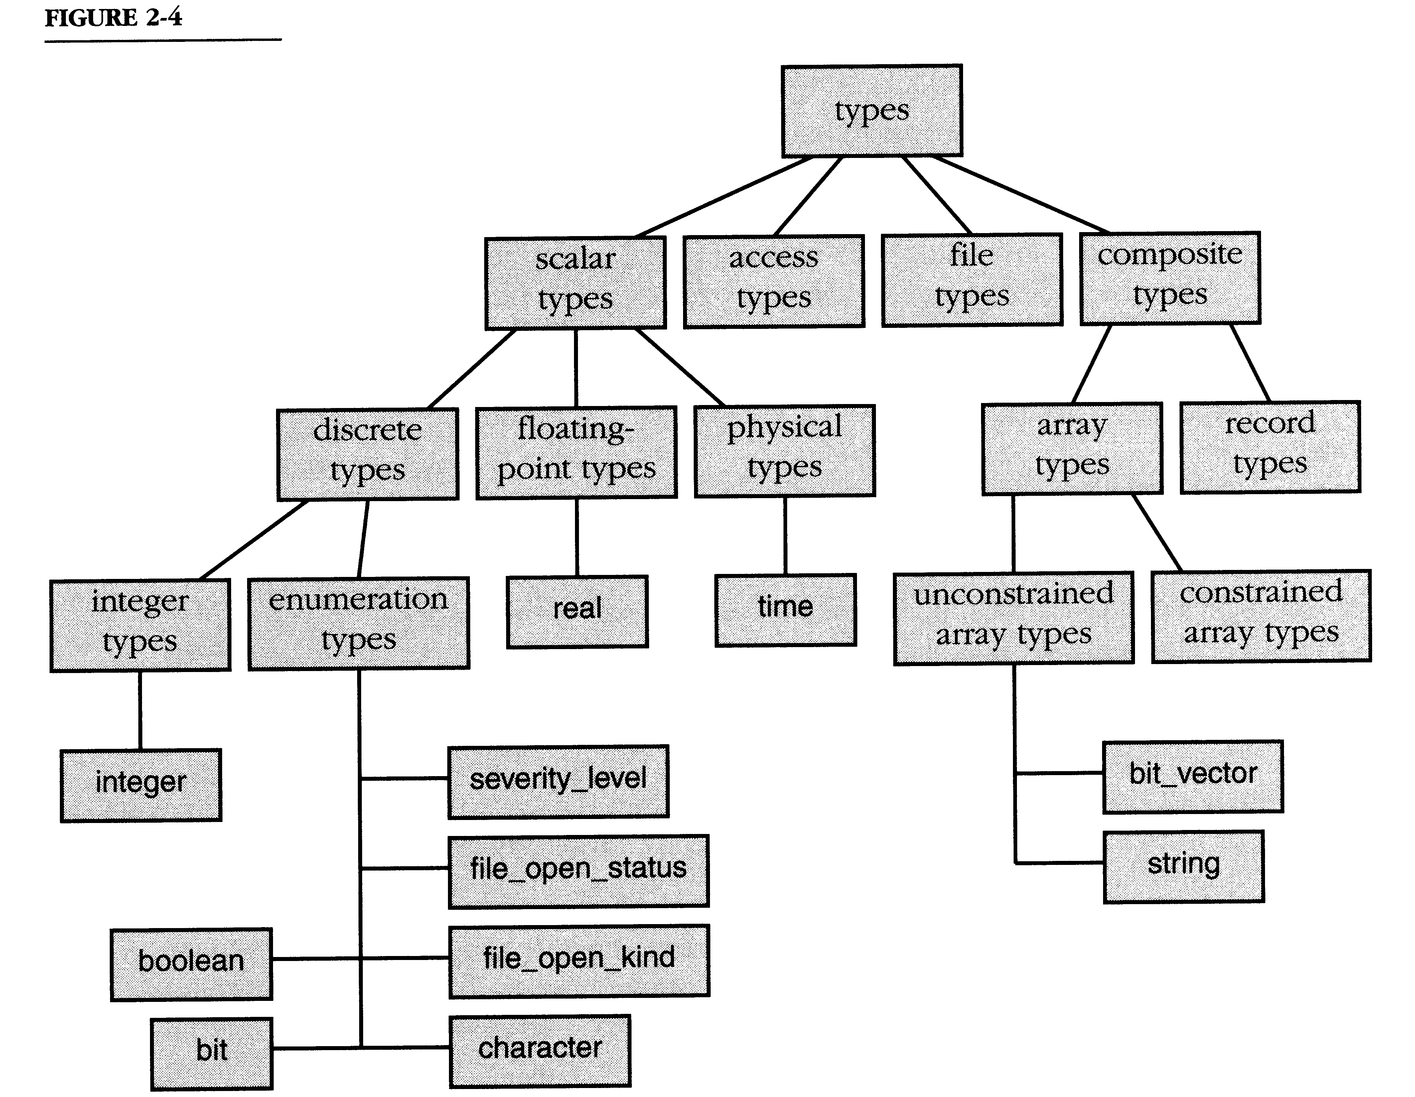
VHDL type classification
See SG p 51, DG p 47.
10 ns
125
“101110001110001”
FALSE
‘1’
‘A’

Slide 8
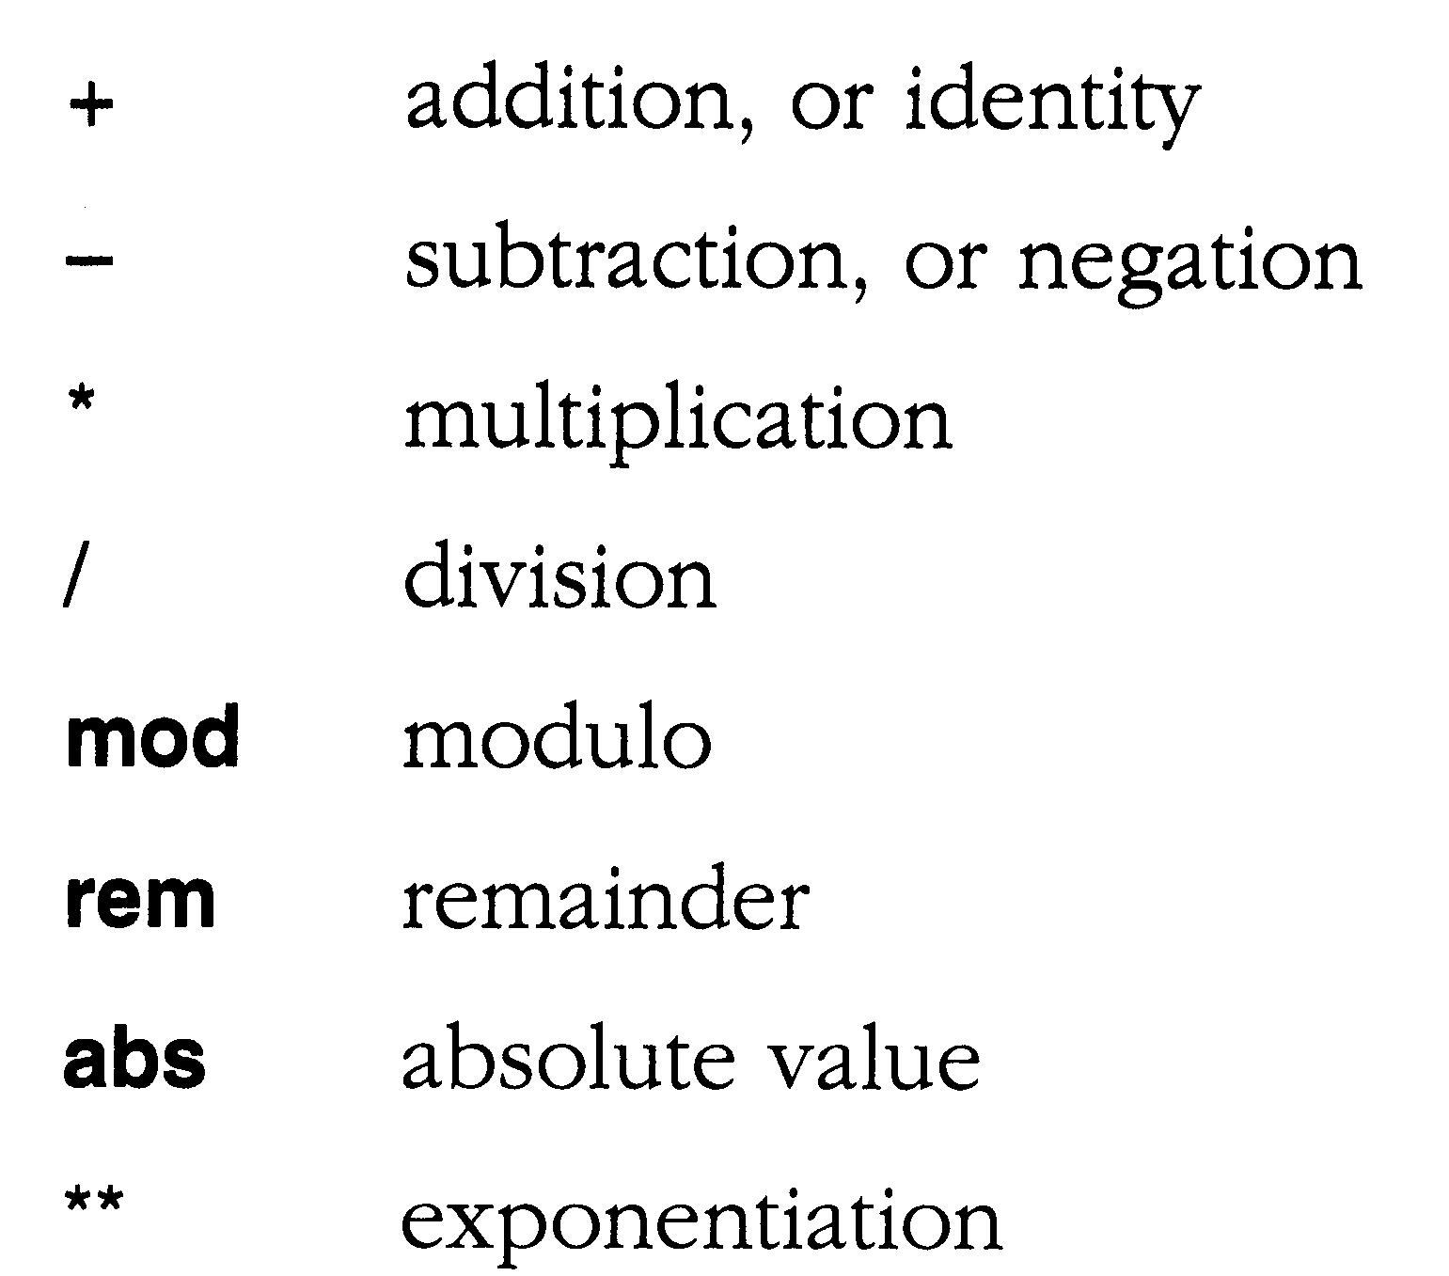
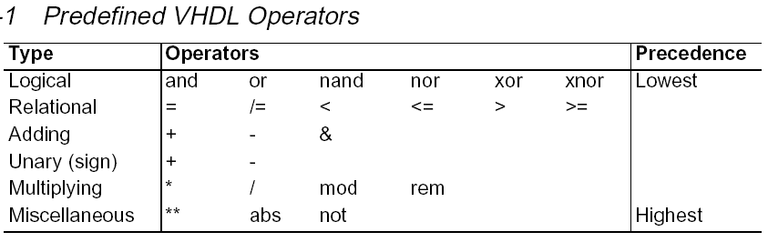
Operations that can be performed on type integer. See SG p 36, DG p 35
Use parentheses to force desired
Precedence.

Slide 9
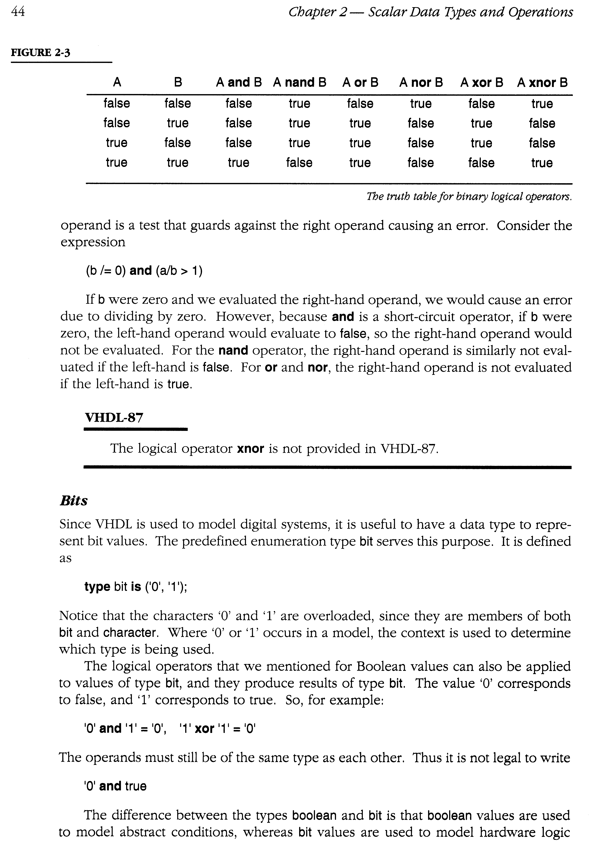
Operations on type Boolean and type Bit. See p46
Note: For type bit replace false with ‘0’ and true with ‘1’.
Legal
Not legal

Slide 10
Constants, variables, and signals
An object is a named item in a VHDL model that has a value of a specific type. There are four classes of objects: constants, variables, signals, and files.
The use of constants and variables in VHDL is similar to what you are already familiar with from other programming languages.
The idea of a signal is a new concept required because in VHDL we are modeling electrical (digital) systems.
  Signals usually represent voltages on wires.
  But you can also use a signal in place of a variable.
  Sometimes it may not matter if you use a signal or a variable.
  Other times there may be subtle reasons for using one over the other.
  Initially you may tend to be confused by the distinction between signals and variables, but this will be made clear later.
We will postpone the discussion of files till later.
Objects must be declared prior to use.

Slide 11
Constants
constant CONST_NAME: <type_spec> := <value>;
-- Examples of Declaration of Constants:
constant GO: BOOLEAN := TRUE;
constant Max: INTEGER := 31;
constant HexMax: INTEGER := 16#FF#; -- hex (base 16) integer
constant ONE: BIT := '1';
constant S0: BIT_VECTOR (3 downto 0) := "0000";
constant S1: bit_vector(15 downto 0) := X"AB3F“; -- hex string
constant HiZ: STD_LOGIC := 'Z'; -- Here Z is high impedance.
constant Ready: STD_LOGIC_VECTOR (3 downto 0) := "0-0-"; -- 0’s & don’t cares
Note: VHDL is not case sensitive. -- is used for comments.
BOOLEAN, INTEGER, BIT, etc are examples of predefined VHDL types.
  VHDL is a strongly typed language.
  Cannot for example directly assign a bit or std_logic value to an integer type.

Slide 12
Variables
VAR_NAME := <expression>;
-- example
Count := 10;
Vbit := '0';
Declaration
variable VAR_NAME: <type_spec>;
-- example:
variable Test: BOOLEAN;
variable Count: INTEGER range 0 to 31 := 15; -- Set initial value to 15.
variable vBIT: BIT;
variable VAR: BIT_VECTOR (3 downto 0);
variable VAR_X: STD_LOGIC := ‘0’; -- Set initial value to ‘0’.
variable VAR_Y: STD_LOGIC_VECTOR (0 to 3);

Slide 13
Signals
SIG_NAME <= <expression>;
-- Examples
BitX <= ‘1’;
Declaration
signal SIG_NAME: <type_spec>;
-- example:
signal Flag: BOOLEAN := TRUE; -- TRUE is the initial vlaue
signal intX: INTEGER range 0 to 31;
signal BitX: BIT := ‘1’;
signal Control_Bus: BIT_VECTOR (3 downto 0);
signal X: STD_LOGIC;
signal Y: STD_LOGIC_VECTOR (0 to 3) := “0000”;

Slide 14
Signals
Events, Propagation Delay, and Concurrency
Signals
  Signals of type bit take on values of 0 and 1.
  Digital components (gates, flip-flops, etc.) respond to input signals to produce output signals.
  A signal change is called an event.
  The effect of an event is delayed by the propagation delay through the component. VHDL allows for associating a delay with a signal.
    Z <= X and Y after 2 ns;
  Signals may propagate through several components concurrently.
    Z <= X and Y after 2 ns;
    V <= (Z xor not W) nand X after 3 ns;
    W <= X or Y after 1 ns;
  VHDL is an event driven concurrent programming language.
    Statements don’t necessarly execute sequentially.
    This makes VHDL “hard.”
An event on X may cause an event on some or all of the signals Z, V, and W.

Slide 15
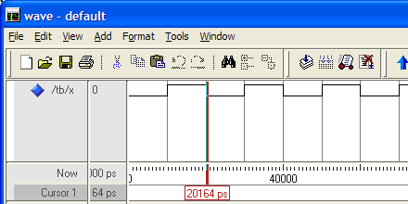
VHDL example EX 1
--EX1.vhd
ENTITY tb is END tb;
ARCHITECTURE test OF tb IS
signal X : BIT;
BEGIN
X <= not X after 10 ns;
END test;

Slide 16
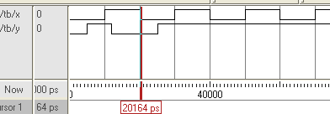
--EX2.vhd
ENTITY tb is END tb;
ARCHITECTURE test OF tb IS
signal X, Y : BIT;
BEGIN
X <= not X after 10 ns;
Y <= '1' after 5 ns, '0' after 12 ns, '1' after 25 ns;
END test;

Slide 17
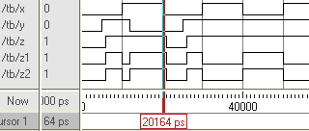
--EX3.vhd
ENTITY tb is END tb;
ARCHITECTURE test OF tb IS
signal X, Y : BIT;
signal Z, Z1, Z2: BIT;
BEGIN
X <= not X after 10 ns;
Y <= '1' after 5 ns, '0' after 12 ns, '1' after 25 ns;
Z <= X or Y after 1 ns;
Z1 <= (X and Y) xor Z;
Z2 <= Z xor (X and Y);
END test;

Slide 18
Another VHDL example EX4
-- EX4 - Signal example
-- File: ex4.vhd
entity ex4 is
end entity ex4;
architecture ex_arc of ex4 is
signal X: BIT;
signal Y: BIT;
signal Z, V, W: BIT;
begin
-- concurrent signals assignments
X <= not X after 10 ns;
Y <= not Y after 25 ns;
Z <= X and Y after 2 ns;
V <= (Z xor not W) nand X after 3 ns;
W <= X or Y after 1 ns;
end architecture ex_arc;

Slide 19
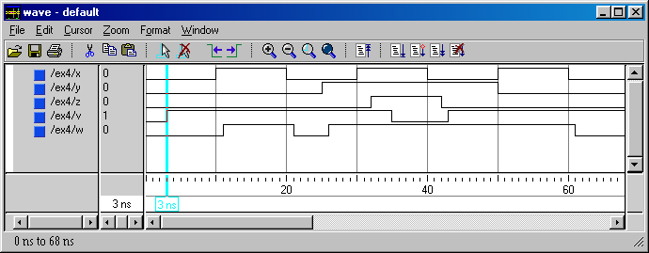
X <= not X after 10 ns;
Y <= not Y after 25 ns;
Z <= X and Y after 2 ns;
V <= (Z xor not W) nand X after 3 ns;
W <= X or Y after 1 ns;

Slide 20
std_logic_1164 multi-value logic system
TYPE std_ulogic IS ( 'U', -- Uninitialized
'X', -- Forcing Unknown
'0', -- Forcing 0
'1', -- Forcing 1
'Z', -- High Impedance
'W', -- Weak Unknown
'L', -- Weak 0
'H', -- Weak 1
'-' -- Don't care );

Slide 21
resolution function – resolves two drives for a single signal. Std_logic has a built in resolution function.
‘X’ indicates an unknown value. This can be caused by the resolution function as shown below.
S <= ‘1’;
S <= ‘0’;
Don’t drive signal from multiple sources!
CONSTANT resolution_table : stdlogic_table := (
-- ---------------------------------------------------------
-- | U X 0 1 Z W L H - | |
-- ---------------------------------------------------------
( 'U', 'U', 'U', 'U', 'U', 'U', 'U', 'U', 'U' ), -- | U |
( 'U', 'X', 'X', 'X', 'X', 'X', 'X', 'X', 'X' ), -- | X |
( 'U', 'X', '0', 'X', '0', '0', '0', '0', 'X' ), -- | 0 |
( 'U', 'X', 'X', '1', '1', '1', '1', '1', 'X' ), -- | 1 |
( 'U', 'X', '0', '1', 'Z', 'W', 'L', 'H', 'X' ), -- | Z |
( 'U', 'X', '0', '1', 'W', 'W', 'W', 'W', 'X' ), -- | W |
( 'U', 'X', '0', '1', 'L', 'W', 'L', 'W', 'X' ), -- | L |
( 'U', 'X', '0', '1', 'H', 'W', 'W', 'H', 'X' ), -- | H |
( 'U', 'X', 'X', 'X', 'X', 'X', 'X', 'X', 'X' ) -- | - |
);

Slide 22
Why have ‘U’ in std_logic types?
Any uninitialized type assumes the left most value of that type.
  TYPE std_logic IS ( 'U', 'X', '0', '1', 'Z', 'W', 'L', 'H', '-' );
  TYPE BIT is (‘0’, ‘1’);
What is the initial value?
  variable vBIT: BIT;
  variable VAR_X: STD_LOGIC := ‘0’;
  signal BitX: BIT := ‘1’;
  signal X: STD_LOGIC;
  Signal N: integer;

Slide 23
Recall EX2: Let’s use std_logic in place of bit.
--EX2.vhd
ENTITY tb is END tb;
ARCHITECTURE test OF tb IS
signal X, Y : BIT;
BEGIN
X <= not X after 10 ns;
Y <= '1' after 5 ns, '0' after 12 ns, '1' after 25 ns;
END test;

Slide 24
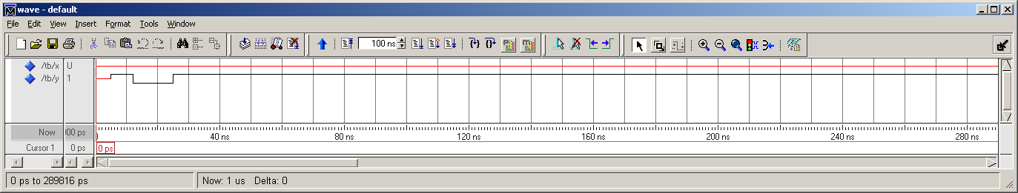
--EX2.vhd Using STD_LOGIC
LIBRARY IEEE;
USE IEEE.std_logic_1164.ALL;
ENTITY tb is END tb;
ARCHITECTURE test OF tb IS
signal X, Y : STD_LOGIC;
BEGIN
X <= not X after 10 ns;
Y <= '1' after 5 ns, '0' after 12 ns, '1' after 25 ns; END test;

Slide 25
What happened?
In VHDL uninitialized signals and variables assume the left most value of the type.
  STD_LOGIC initializes to “U”.
X <= not X after 10 ns;
Y <= '1' after 15 ns, '0' after 25 ns;
-- truth table for "not" function
CONSTANT not_table: stdlogic_1d :=
-- -------------------------------------------------
-- | U X 0 1 Z W L H - |
-- -------------------------------------------------
( 'U', 'X', '1', '0', 'X', 'X', '1', '0', 'X' );

Slide 26
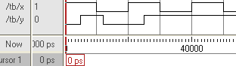
ENTITY tb is END tb;
ARCHITECTURE test OF tb IS
signal X: STD_Logic := '1';
Signal Y : STD_LOGIC := '0';
BEGIN X <= not X after 10 ns; Y <= '1' after 5 ns, '0' after 12 ns, '1' after 25 ns; END test;
--EX2.vhd Using STD_LOGIC
-- with initialization
LIBRARY IEEE;
USE IEEE.std_logic_1164.ALL;
ENTITY tb is END tb;

Slide 27
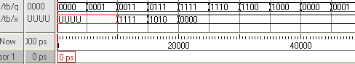
A more complicated example using IEEE.STD_LOGIC_ARITH
LIBRARY IEEE;
USE work.all;
USE IEEE.Std_Logic_1164.all;
use IEEE.STD_LOGIC_ARITH.ALL;
use IEEE.STD_LOGIC_UNSIGNED.ALL;
ENTITY tb is END tb;
ARCHITECTURE test OF tb IS
constant ALL_ONES: std_logic_vector(3 downto 0) := X"F";
constant Some_Ones: std_logic_vector(3 downto 0) := X"A";
SIGNAL Q : std_logic_vector(3 downto 0) := (others => '0'); --"0000";
signal X : std_logic_vector(3 downto 0);
BEGIN
Q <= Q(2 downto 0) & not Q(3) after 5 ns;
X <= ALL_ONES after 10 ns, Some_Ones after 15 ns, "0000" after 20 ns;
END test;

Slide 28
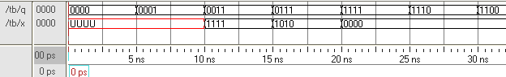
LIBRARY IEEE;
USE work.all;
USE IEEE.Std_Logic_1164.all;
use ieee.numeric_std.all;
ENTITY tb is END tb;
ARCHITECTURE test OF tb IS
constant ALL_ONES: unsigned(3 downto 0) := X"F";
constant Some_Ones: unsigned(3 downto 0) := X"A";
SIGNAL Q : unsigned(3 downto 0) := (others => '0'); --"0000";
signal X : unsigned(3 downto 0);
BEGIN
Q <= Q(2 downto 0) & not Q(3) after 5 ns;
X <= ALL_ONES after 10 ns, Some_Ones after 15 ns, "0000" after 20 ns;
END test;
Same example using numeric package.
The numeric package defines unsigned to be a std_locic_vector that is treated as an unsigned vector. (You can also have a signed vector).

Slide 29
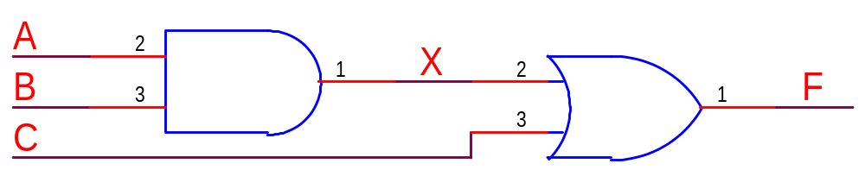
And Or gate in VHDL example
library IEEE;use IEEE.STD_LOGIC_1164.ALL;
use IEEE.STD_LOGIC_ARITH.ALL;
use IEEE.STD_LOGIC_UNSIGNED.ALL;
entity ABorC is
port (A : in std_logic; B : in std_logic;
C : in std_logic; F : out std_logic);
end ABorC;
architecture arch of ABorC is
signal X : std_logic;
begin
X <= A and B after 1 ns;
F <= X or C after 1 ns;
end;
Instead of the numeric package we will normally use the arithmetic package and the associated unsigned package. But the numeric package would work equally well.

Slide 30
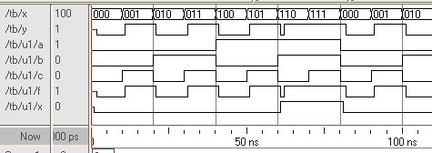
Test bench for and or example
LIBRARY IEEE;USE work.all;
USE IEEE.Std_Logic_1164.all;
use IEEE.STD_LOGIC_ARITH.ALL;
use IEEE.STD_LOGIC_UNSIGNED.ALL;
ENTITY tb IS END ENTITY tb;
Architecture TEST of tb is
SIGNAL X: std_logic_vector (2 downto 0) := "000";
SIGNAL Y: std_logic;begin
U1: ENTITY work.ABorC(arch)
PORT MAP(A => X(2), B => X(1), C => X(0), F => Y);
X <= X + 1 after 10 ns;
end test;

Slide 31
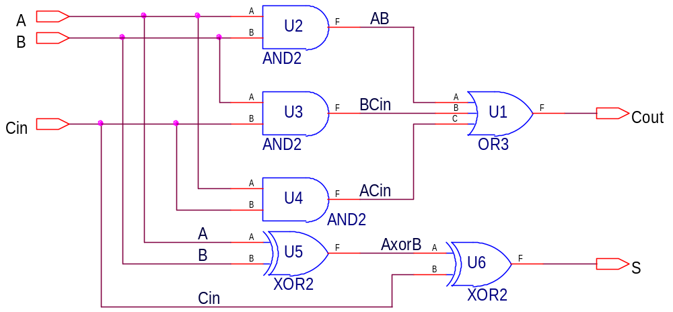
U1: entity work.or3 port map
(A => AB, B => ACin , C => BCin , F => Cout);
U2: entity work.and2 port map
(A => A, B => B, F => AB);
U3: entity work.and2 port map
(A => B, B => Cin, F => BCin);
U4: entity work.and2 port map
(A => A, B => Cin, F => ACin);
U5: entity work.xor2 port map (A, B, AxorB);
U6: entity work.xor2 port map (Cin, AxorB, S);

Slide 32
VHDL design units
Configuration
Package
Package Body
Entity
  Describes Interface
    Describes how the circuit appears form the outside.
    Similar to a schematic symbol.
Architecture
  Specifies function
    Describes how the circuit does what it does.
  RTL
  Behavioral
  Structural
Initially we will focus on the Entity and Architecture.
  Both are always necessary the others are optional.
See DG chapter 5

Slide 33
Process
The process is a fundamental concept in VHDL
Processes are contained within an architecture.
  An architecture may contain several processes.
Processes execute concurrently (at the same time)
  Code within a process execute sequentially. (See chapter 3.)
Combinational circuits can be modeled without using process.
Sequential circuits need processes.
Processes provide powerful statements not available outside processes.
Example
process (A, B)
F <= A xor B;
end process;
Sensitivity list

Slide 34
Process
Process statements occur within an architecture.
The syntax for a process is:
LABEL1: -- optional label
process (signal_name, …) is
-- declarations
begin
-- sequential statements
end process LABEL1;

Slide 35
Process example
With process statements
Without process statements
architecture ex_arc of ex4 is
signal X: BIT;
signal Y: BIT;
signal Z, V, W: BIT;
Begin
-- concurrent signals assignments
X <= not X after 10 ns;
Y <= not Y after 25 ns;
Z <= X and Y after 2 ns;
V <= (Z xor not W) nand X after 3 ns;
W <= X or Y after 1 ns;
end architecture ex_arc;
Process(X) begin
X <= not X after 10 ns;
End process;
P2: process(y) begin
Y <= not Y after 25 ns;
End process P2;
P3: Process(X,Y,Z,W)
begin
Z <= X and Y after 2 ns;
V <= (Z xor not W) nand X after 3 ns;
End process P3;
P4: process(X,Y) begin
W <= X or Y after 1 ns;
End process P4;

Slide 36
A VHDL example illustrating that signals are updated when the process suspends.
ARCHITECTURE test OF tb IS
signal CLK: std_logic := '0'; -- Initial vlaue of '0'
signal X: INTEGER := 0; -- Initial value of 0
BEGIN
-- Make the signal CLK changes every 10 nsec.
CLK <= not CLK after 10 ns; -- CLK changes every 10 nsec
-- States within a process execute sequentially
-- All process are activated at time t = 0.
-- The process below is also activated when CLK changes.
process (CLK)
variable I: INTEGER := 0; -- Initial value of 0
begin
I := I + 3;
X <= X + 3;
I := I + 2;
X <= X + 2;
I := I + 1;
X <= X + 1;
end process;
END test;
The process is activated at time t = 0 and when signal CLK changes.
Signals are not updated until the process suspends.

Slide 37
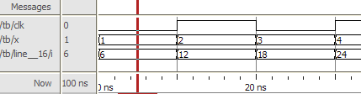
A VHDL example continued
CLK <= not CLK after 10 ns;
process (CLK)
variable I: INTEGER := 0; -- Initial value of 0
begin -- signal X is an integer with initial value of 0
I := I + 3;
X <= X + 3;
I := I + 2;
X <= X + 2;
I := I + 1;
X <= X + 1;
end process;
END test;

Slide 38
Example mod 10 counter
LIBRARY IEEE;
USE work.all;
USE IEEE.Std_Logic_1164.all;
use ieee.numeric_std.all;
ENTITY ExMod10 IS
PORT
(
CLK: in std_logic;
Count: BUFFER integer range 0 to 9
);
END ENTITY ExMod10;
Architecture Example of ExMod10 is
begin
DoCount: process(clk) is
begin
if falling_edge(clk) then
if count < 9 then
count <= count+1;
else
count <= 0;
end if;
end if;
end process DoCount;
end architecture Example;

Slide 39
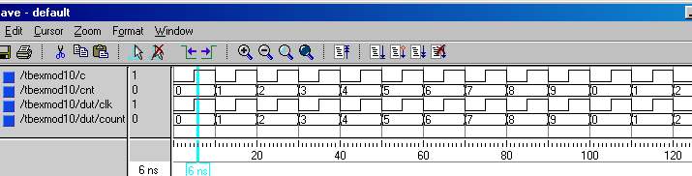
LIBRARY IEEE;
USE work.all;
USE IEEE.Std_Logic_1164.all;
use IEEE.numeric_std.all;
ENTITY tb IS END ENTITY tb;
Architecture TEST of tb is
SIGNAL C: std_logic := '0';
SIGNAL CNT: integer range 0 to 9;
COMPONENT ExMod10
PORT ( CLK: in std_logic;
Count: BUFFER integer range 0 to 9 );
END COMPONENT ExMod10;
VHDL 87 Test bench
begin
DUT: ExMod10
PORT MAP
(
CLK => C, -- Clock at 100 MHz
Count => CNT
);
C <= not C after 5 ns;
end test;

Slide 40
Alternative simpler test bench possible with VHDL 93
LIBRARY IEEE;
USE work.all;
USE IEEE.Std_Logic_1164.all;
use IEEE.numeric_std.all;
ENTITY tb IS END ENTITY tb;
Architecture TEST of tb is
SIGNAL C: std_logic := '0';
SIGNAL CNT: integer range 0 to 9;
begin
DUT: ENTITY ExMod10
PORT MAP
(
CLK => C, -- Clock at 100 MHz
Count => CNT
);
C <= not C after 5 ns;
--end architecture TEST;
end test;

Slide 41
An alternative architecture
LIBRARY IEEE;
USE work.all;
USE IEEE.Std_Logic_1164.all;
use ieee.numeric_std.all;
ENTITY ExMod10 IS
PORT
(
CLK: in std_logic;
Count: BUFFER integer range 0 to 9
);
END ENTITY ExMod10;
Architecture Example of ExMod10 is
begin
DoCount: process(clk) is
begin
if falling_edge(clk) then
-- if count < 9 then
count <= count+1;
-- else
-- count <= 0;
-- end if;
end if;
end process DoCount;
end architecture Example;

Slide 42
Using OUT instead of BUFFER
Note: Here we are using IEEE.STD_LOGIC_ARITH.ALL
LIBRARY IEEE;
USE work.all;
USE IEEE.Std_Logic_1164.all;
use IEEE.STD_LOGIC_ARITH.ALL;
use IEEE.STD_LOGIC_UNSIGNED.ALL;
ENTITY ExMod10 IS
PORT
(
CLK: in std_logic;
Count: OUT integer range 0 to 9
);
END ENTITY ExMod10;

Slide 43
Using a temporary signal CNT.
Architecture SIG of ExMod10 is
signal CNT: INTEGER RANGE 0 TO 9;
begin
DoCount: process(clk) is
begin
if CLK'EVENT AND CLK = '0' then
CNT <= (CNT+1) mod 10;
end if;
end process;
Count <= CNT;
end architecture SIG;

Slide 44
Alternative architecture using a temporary variable.
Architecture VAR of ExMod10 is
begin
DoCount: process(clk) is
variable vcount: integer range 0 to 9;
begin
if clk’event and clk = ‘0’ then
vcount := (vcount + 1) mod 10;
count <= vcount;
end if;
end process DoCount;
end architecture VAR;

Slide 45
A test bench
LIBRARY IEEE;
USE work.all;
USE IEEE.Std_Logic_1164.all;
use IEEE.STD_LOGIC_ARITH.ALL;
use IEEE.STD_LOGIC_UNSIGNED.ALL;
ENTITY tb IS END ENTITY tb;
ENTITY tb IS END ENTITY tb;
Architecture TEST of tb is
SIGNAL C: std_logic := '0';
SIGNAL Count_sig: integer range 0 to 9;
signal Count_var: integer range 0 to 9;
begin
DUT: ENTITY work.ExMod10(SIG)
PORT MAP
( CLK => C, -- Clock at 100 MHz
Count => Count_sig );
DUT2: ENTITY work.ExMod10(VAR)
PORT MAP
( CLK => C, -- Clock at 100 MHz
Count => Count_var );
C <= not C after 5 ns;
--end architecture TEST;
end test;
Must specify the particular architecture.

